Slide 1

Data Engineering: Airbnb Project 3 | Group 1

Slide 2

Index
Data & methodology
Key Observations
ERD & ETL
TABLES
Summary & next steps

Slide 3

Key observations

Slide 4
Key Dataset observations
Data Size
Our original raw data was 30k + elements, with 96 columns. At this size, the data was difficult to sift through or interpret. This led us to sample the elements and drop extraneous columns before we even created our original tables
Data Decisions
To provide the most relevant data in our final report, we chose areas of interest that afforded multiple levels of transformation and analysis, and were the most relevant to a client seeking to understand travel consumer needs and preferences
Location
The dataset used was strictly from the Los Angeles area, which makes limitations in how many markets any findings from analysis can be accurately assumed
Data Quality
There were missing pieces of information in the dataset across many of the columns, as well as responses that were in other languages, making it necessary to be particularly cautious in our data cleaning, and in some instances making elements unusable

Slide 5
DATA & METHODOLOGY

Slide 6

Data and Methodology
Objective
To provide our client with Los Angeles Airbnb data that is comprehensive, organized, easily accessible, and ready for analysis.
Data Source
https://www.kaggle.com/datasets/oindrilasen/la-airbnb-listings
Methods
ERD: Data Transformation Planning
ETL: Data Transformation, Storage & Retrieval
Python
Pandas, NLTK, TextBlob, NumPy
PostgreSQL & SQLAlchemy

Slide 7
Erd & ETL

Slide 8
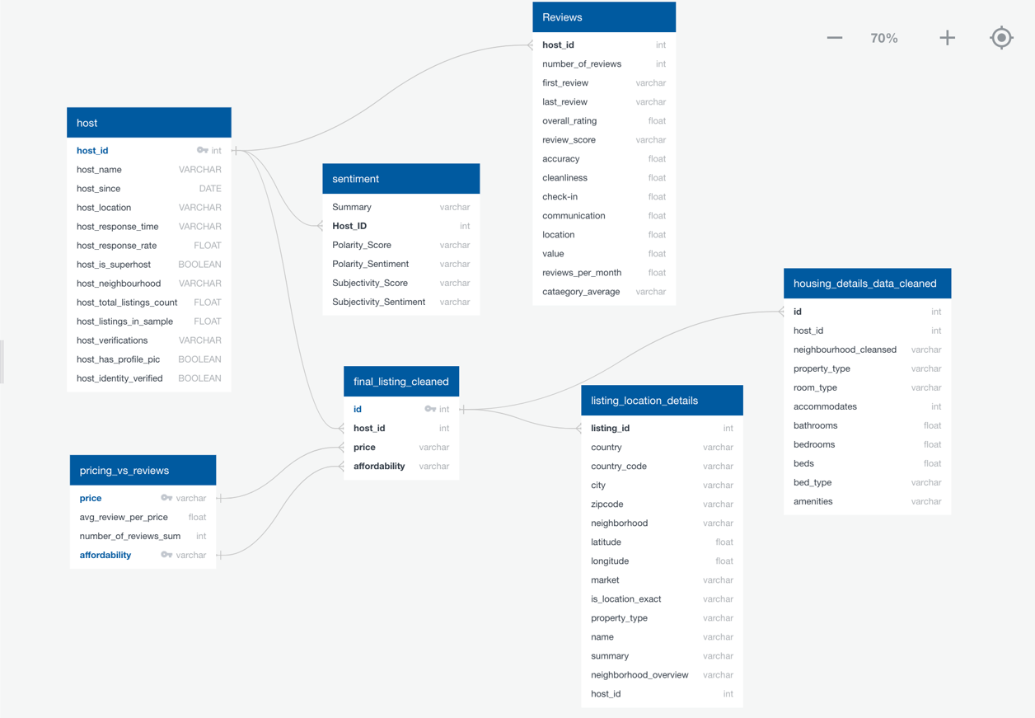
Data retrieval and transformation
Entity Relationship Diagram
Notes:
Extract - Original data was extracted from an open-source data set in Kaggle and stored in the project GitHub repository
Transform - Using Python (specifically pandas), the data was trimmed, sampled, and organized into several linkable tables addressing different areas of interest
Load - The organized data was inserted in PostgreSQL tables individually, and then joined back into a final, analysis ready dataframe stored using SQLAlchemy

Slide 9
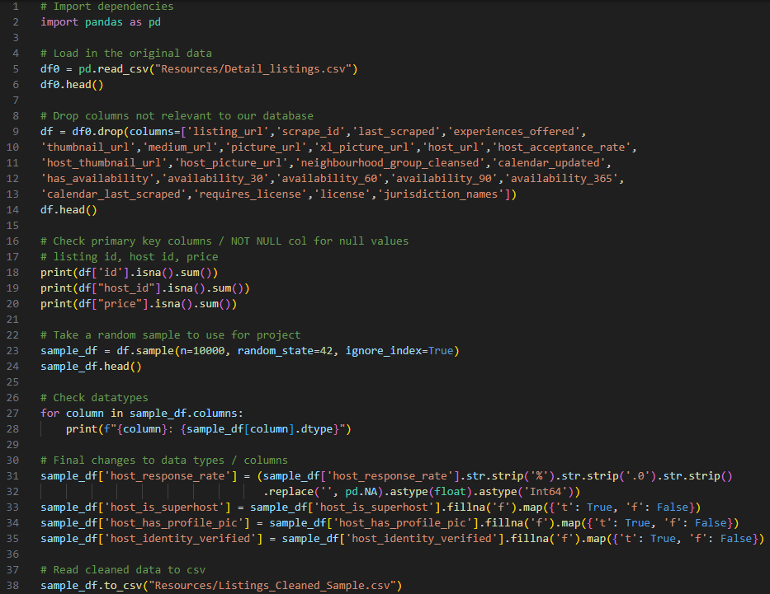
Primary Dataset Creation Truncated for reporting purposes
Notes:
Don’t talk about this, just here for a quick view and move on. NOT INCLUDED IN OUR SPEAKING TIME

Slide 10
tables

Slide 11
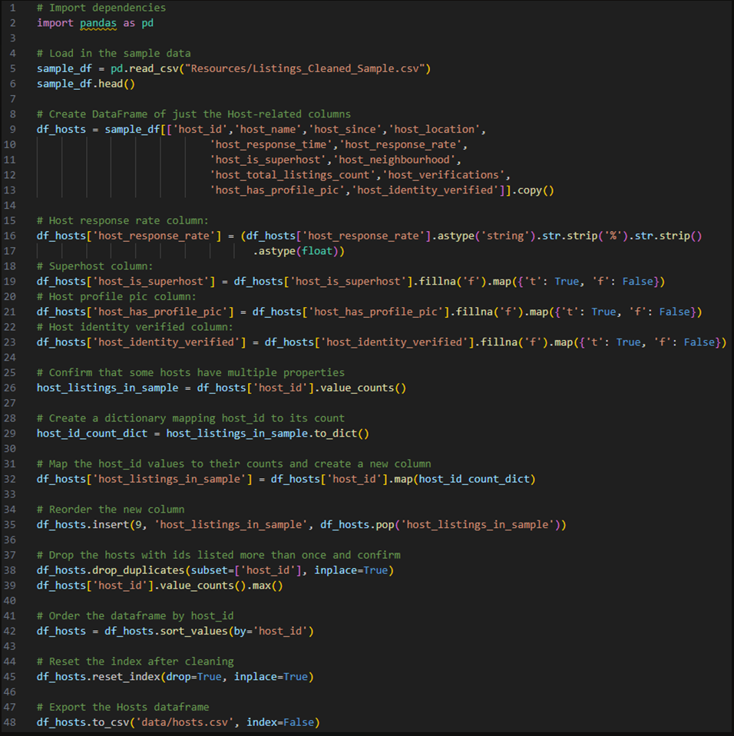
Hosts Truncated for reporting purposes
Notes:
Don’t talk about this, just here for a quick view and move on. NOT INCLUDED IN OUR SPEAKING TIME

Slide 12
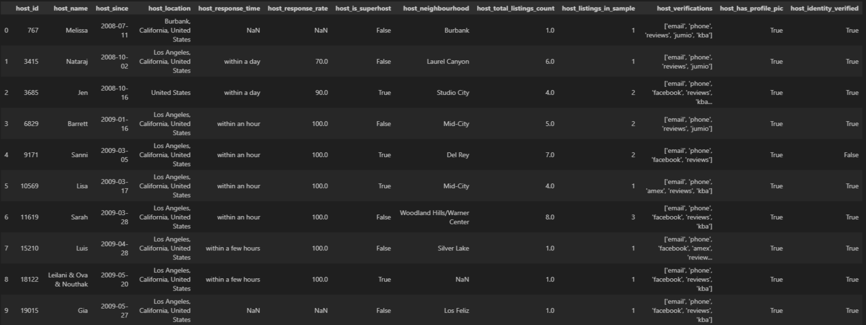
hosts
The host table was created by reducing the primary dataset to columns exclusively related to host information.
Hosts Table
Notes:
NEEDS NOTES

Slide 13
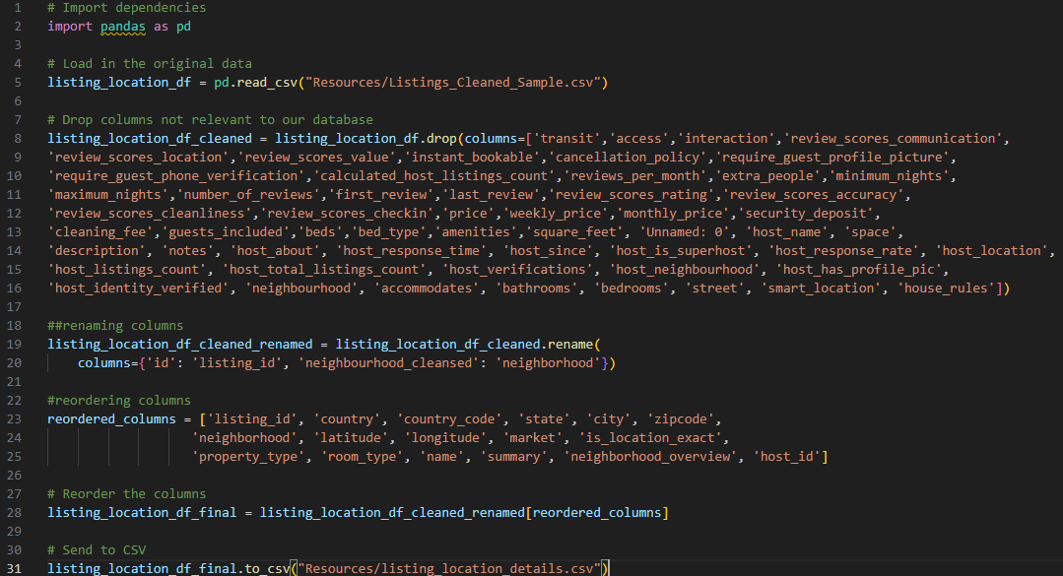
Location Details Truncated for reporting purposes
Notes:
Don’t talk about this, just here for a quick view and move on. NOT INCLUDED IN OUR SPEAKING TIME

Slide 14
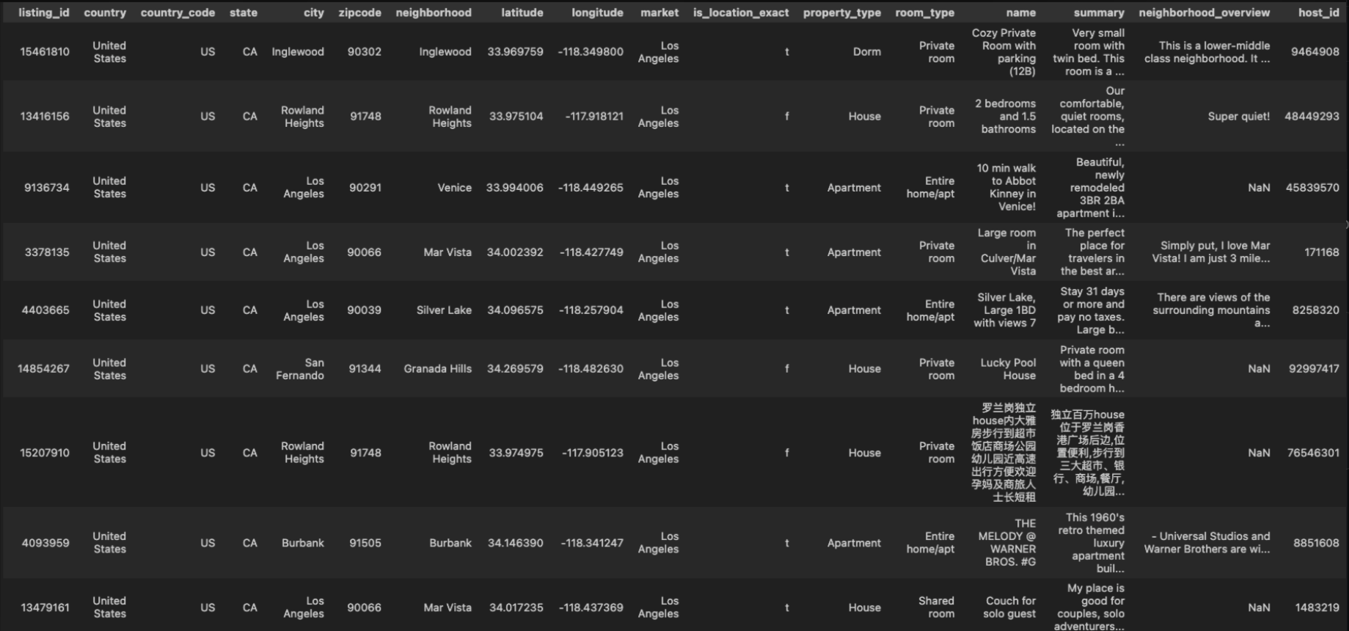
Location details
Location details are shown in their own unique table for easy access. The location data was isolated and merged into a PostgreSQL table.
Listing Location Details Table
Notes:
NEEDS NOTES

Slide 15
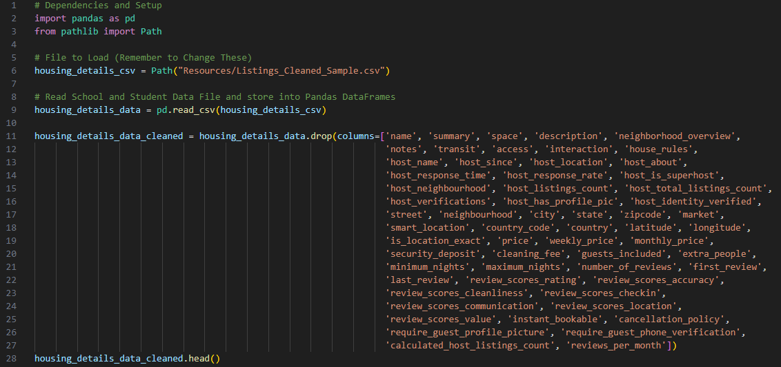
Housing Details Truncated for reporting purposes
Notes:
Don’t talk about this, just here for a quick view and move on. NOT INCLUDED IN OUR SPEAKING TIME

Slide 16
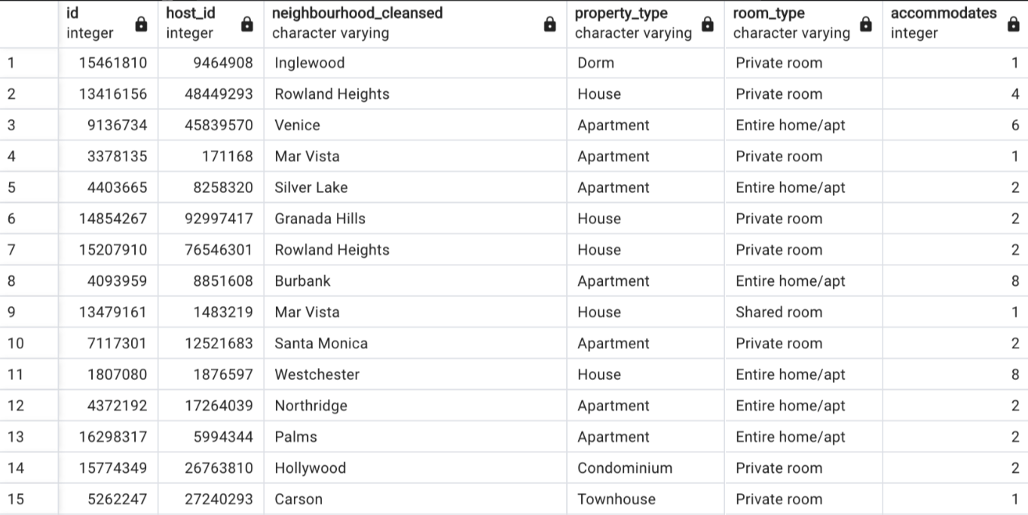
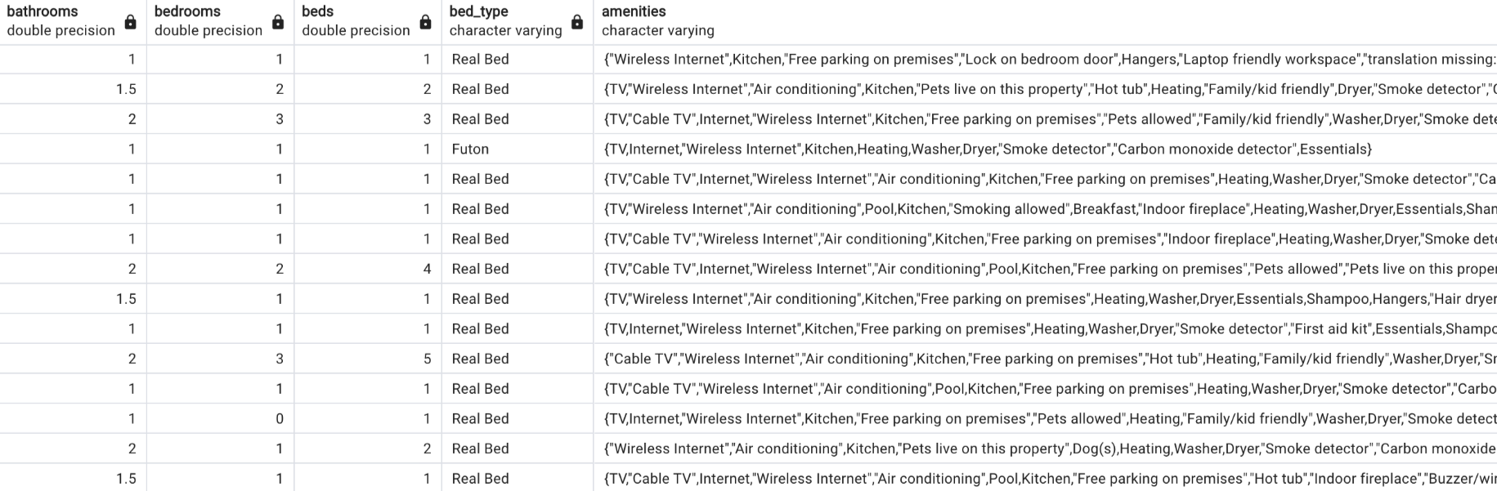
Housing details
Similarly to location, housing details are shown in their own unique table for quick reference. The data was transformed using Pandas and merged into a unique PostgreSQL table.
Housing Details Table
Notes:
NEEDS NOTES

Slide 17
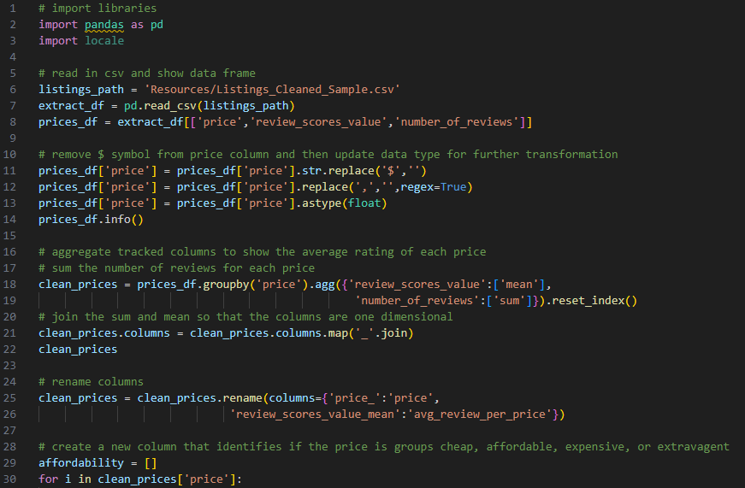
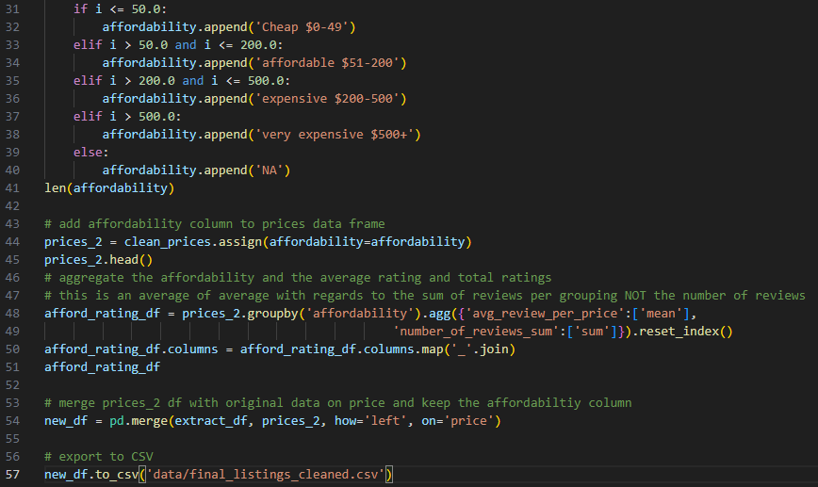
Prices & Reviews Truncated for reporting purposes
Notes:
Don’t talk about this, just here for a quick view and move on. NOT INCLUDED IN OUR SPEAKING TIME

Slide 18
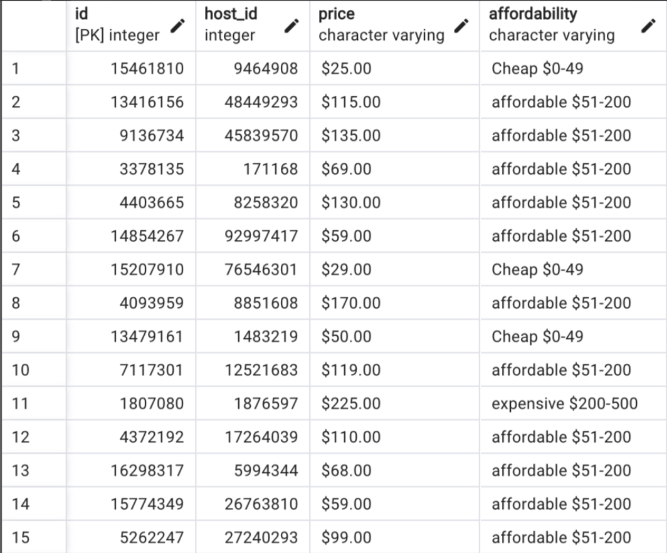
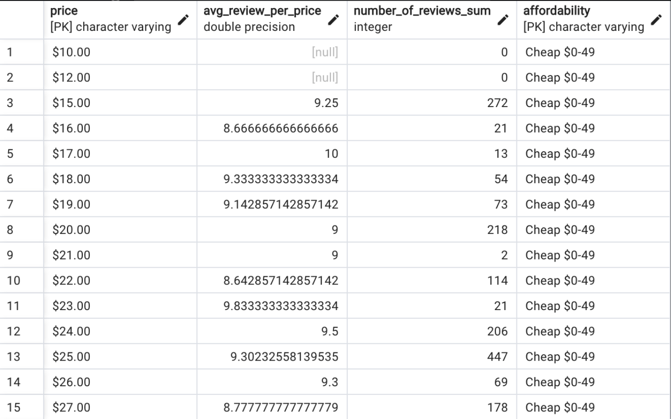
Prices & reviews
The price and reviews table was created by reducing the primary dataset to columns exclusively related to the comparison of pricing and review information. Prices were aggregated by affordability (from cheap to very expensive), average rating, and total rating.
Prices and Reviews Table
Notes:
NEEDS NOTES

Slide 19
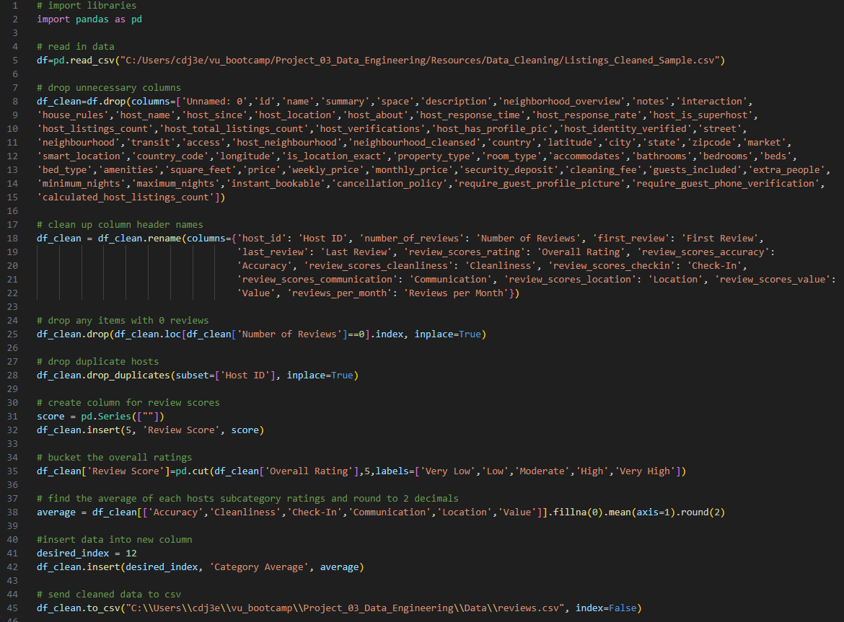
Comprehensive Reviews Truncated for reporting purposes
Notes:
Reduced to only include columns relating to reviews (number of reviews, first/last, overall, categorical)
Bucketed overall ratings to be identified as very low, low, moderate, high, and very high to make it easily sortable and readable
Aggregated all categorical ratings and found the mean to make it easier to view high level appeal of hosts

Slide 20
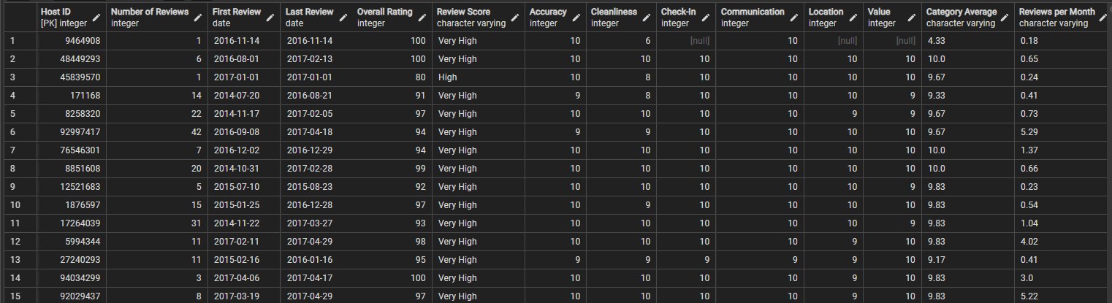
Comprehensive reviews
The comprehensive reviews table was created to provide easy comparison of both overall ratings and host ratings for specific factors. We also created columns for overall review score (from very high to very low) and the average rating across all specific review factors.
Comprehensive Reviews Table
Notes:
NEEDS NOTES

Slide 21
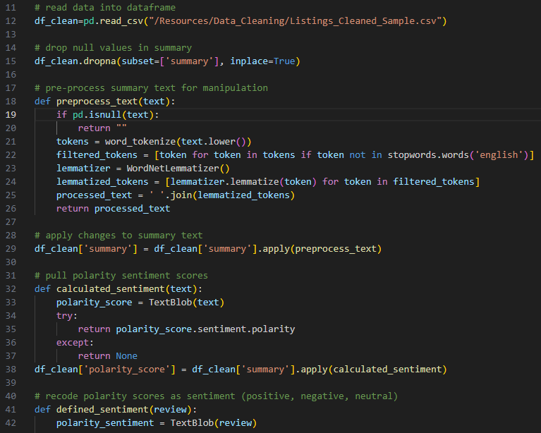
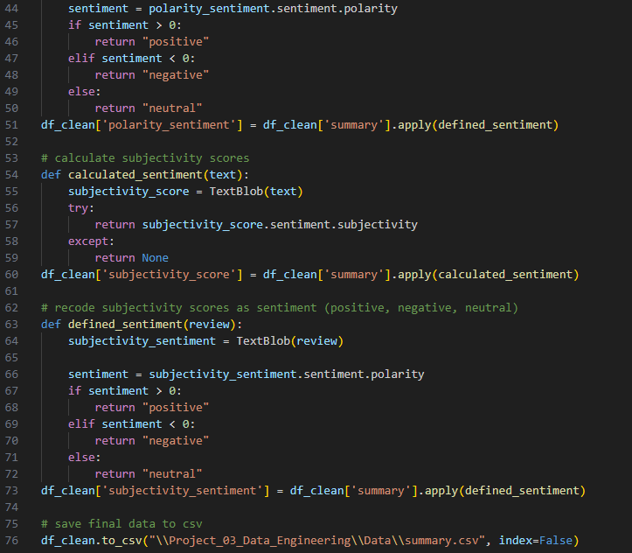
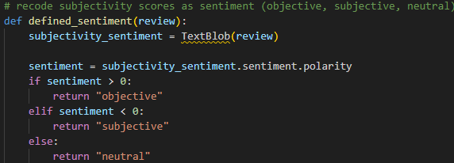
Sentiment Analysis Truncated for reporting purposes
Notes:
Used NLKT and TextBlob libraries in Python
Reduced Dataset to summary and host_id as primary key
Preprocessed the text
Tokenized – Breaks down text into individual words
filtered the tokens
lemmatized tokens – reduces words to their root forms (removes ed, ing, er, etc. like jumping becomes jump)
returned the processed text
Applied the preprocessing to the summary text
Used textblob to calculate polarity scores and then if statements to recode scores as positive negative or neutral
polarity – how positive or negative the statements are
Did the same for subjectivity
subjectivity – how subjective or objective the statements are

Slide 22
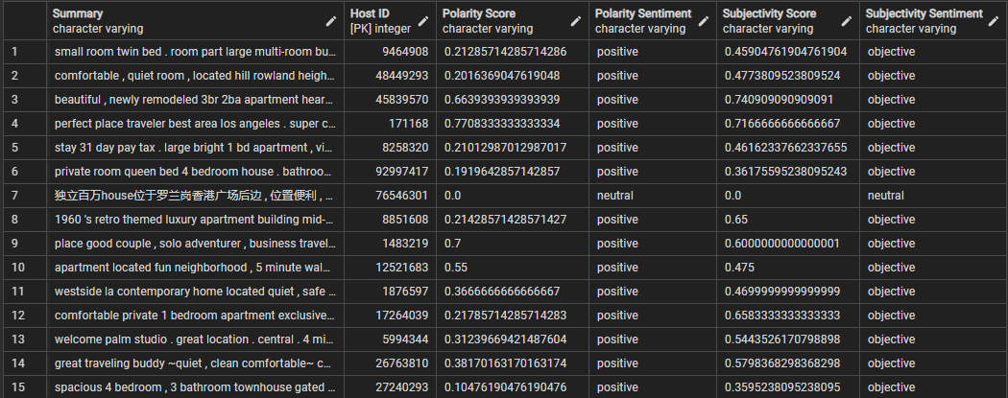
Sentiment analysis
Sentiment analysis was performed on all open-end summary reviews of the Airbnb listings in our sample for polarity (positive, negative, neutral) and subjectivity (subjective, objective, neutral)
Sentiment Analysis Table
Notes:
NEEDS NOTES

Slide 23
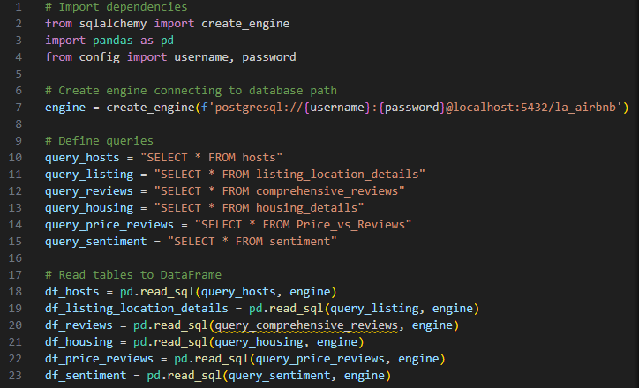
Final Dataframe to PostgreSQL Truncated for reporting purposes
Notes:
Don’t talk about this, just here for a quick view and move on. NOT INCLUDED IN OUR SPEAKING TIME

Slide 24
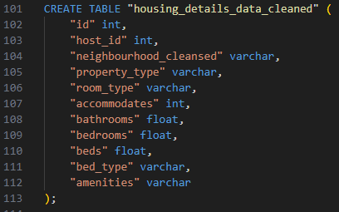
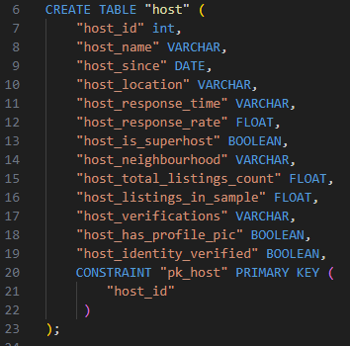
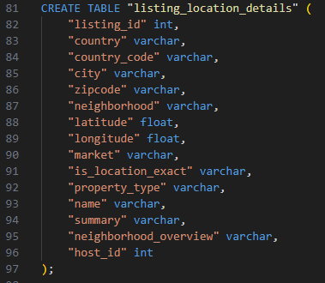
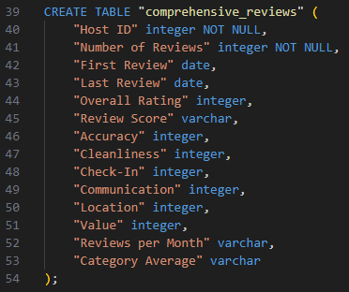
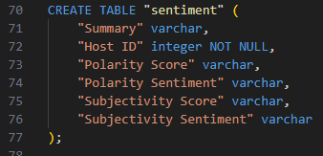
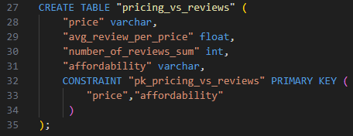
Final dataframe
Our final, analysis-ready dataframe was created by using SQLAlchemy to merge individual pandas dataframes into PostgreSQL for storage.
Final Tables

Slide 25
Summary & next steps

Slide 26
Next steps
There are many ways that we could continue to work with this data. A few natural next steps could include:
Locations:
Could be used to create heat and data density maps to analyze location
Value:
Price and amenity data can be used to create a searchable list of options for the best value depending on price range and amenity preferences
Sentiment:
Subjectivity and polarity sentiment can be aggregated to view overall averages in positive vs. negative feedback, as well as analyzed for trends in specific words associated with each
Data Viewing and Retrieval:
As an additional way to view and retrieve the data, we intend to incorporate a Flask API using JSON, with HTML features to allow for interactive searching and query
Key implications to remember:
Data size – Large amounts of unstructured data needed to be sampled and cleaned before transformation
Data Decisions – We chose the most relevant topics of interest in terms of analysis
Location – Being confined to Los Angeles limits our data use
Data Quality – In order to provide the best data for analysis it was necessary to remove null and unreadable values

Slide 27

THANK YOU
Ben Comfort
Amanda Dunaway
Matt Flanagan
Luis Martinez
Charity Ovando

